Slide 1

Let’s talk (ironically) about the weather
cocolab cogsci update

Slide 2
Some background
An ironic statement describes something as contrary to what it actually is (Roberts & Kreuz, 1994; Gibbs & Colston, 1999)
Listener relies heavily on common ground to produce a corrective response and recover the speaker’s intended meaning
Several informal theories, but not much detailed understanding of what makes an utterance ironic, or how people arrive at ironic interpretations
We propose a natural extension to the hyperbole model, but with additional affect dimension

Slide 3
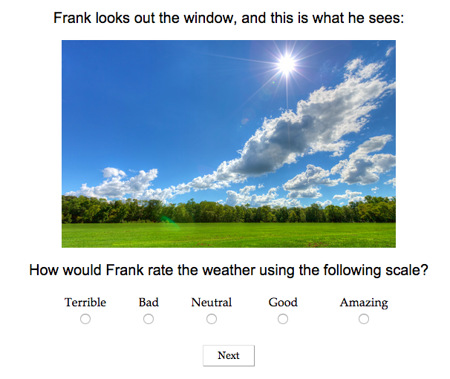

Slide 4
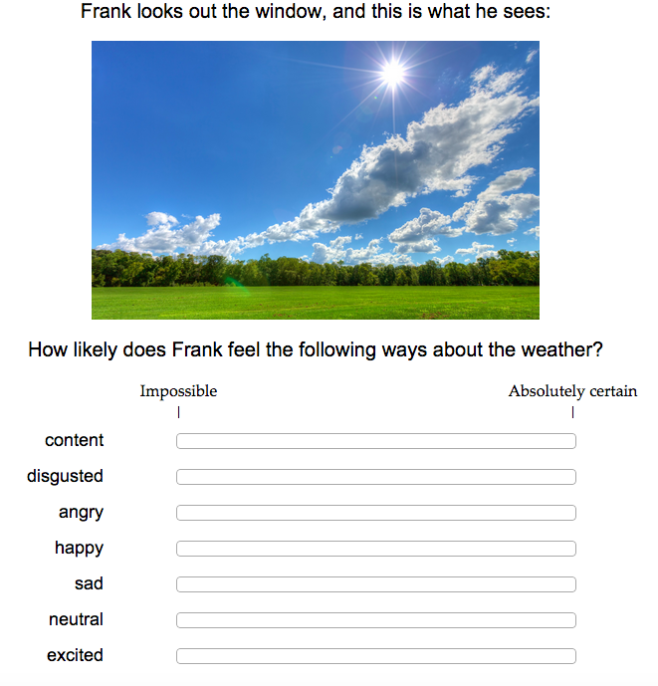

Slide 5


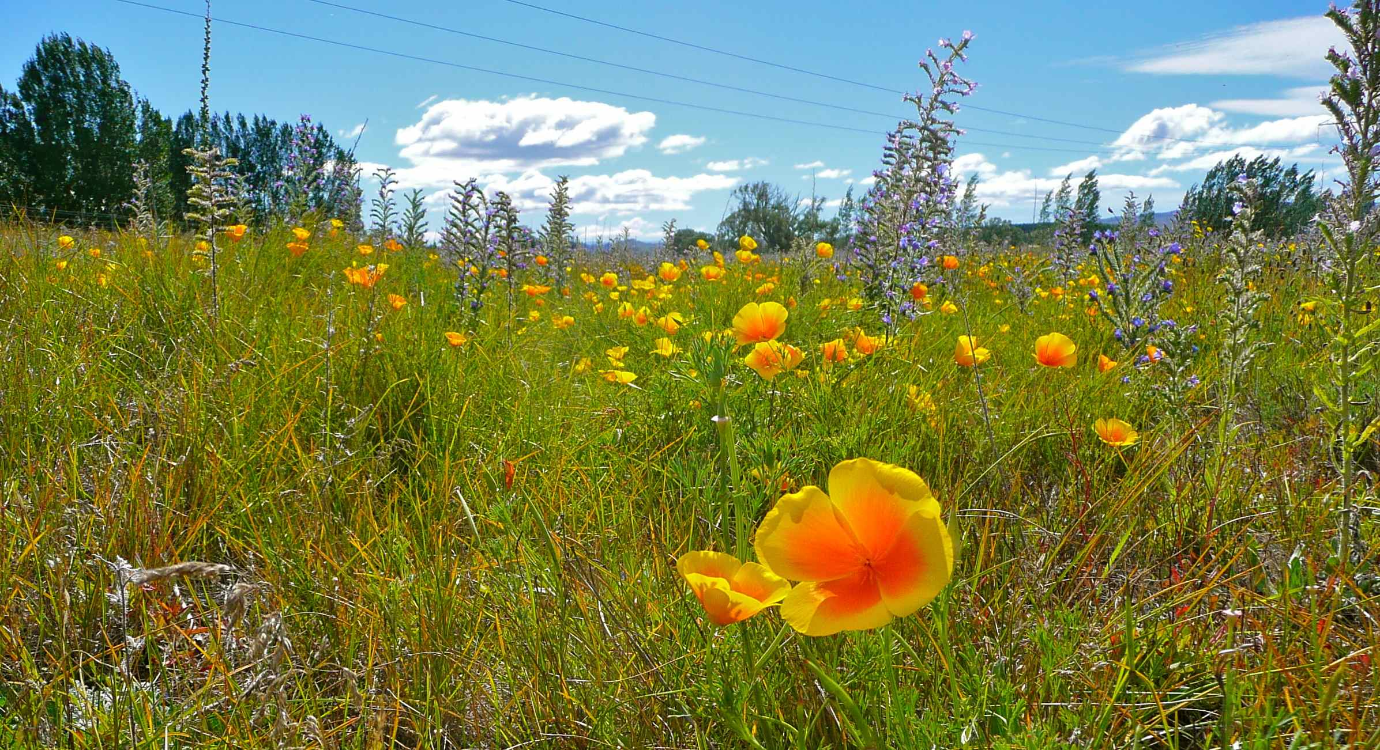
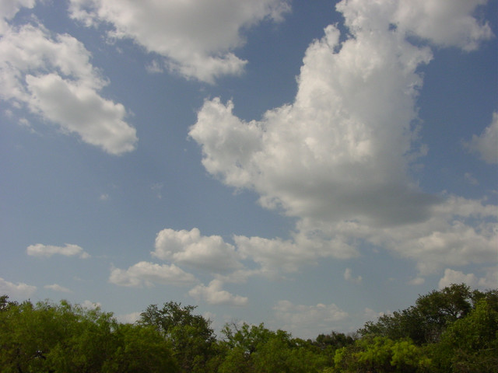

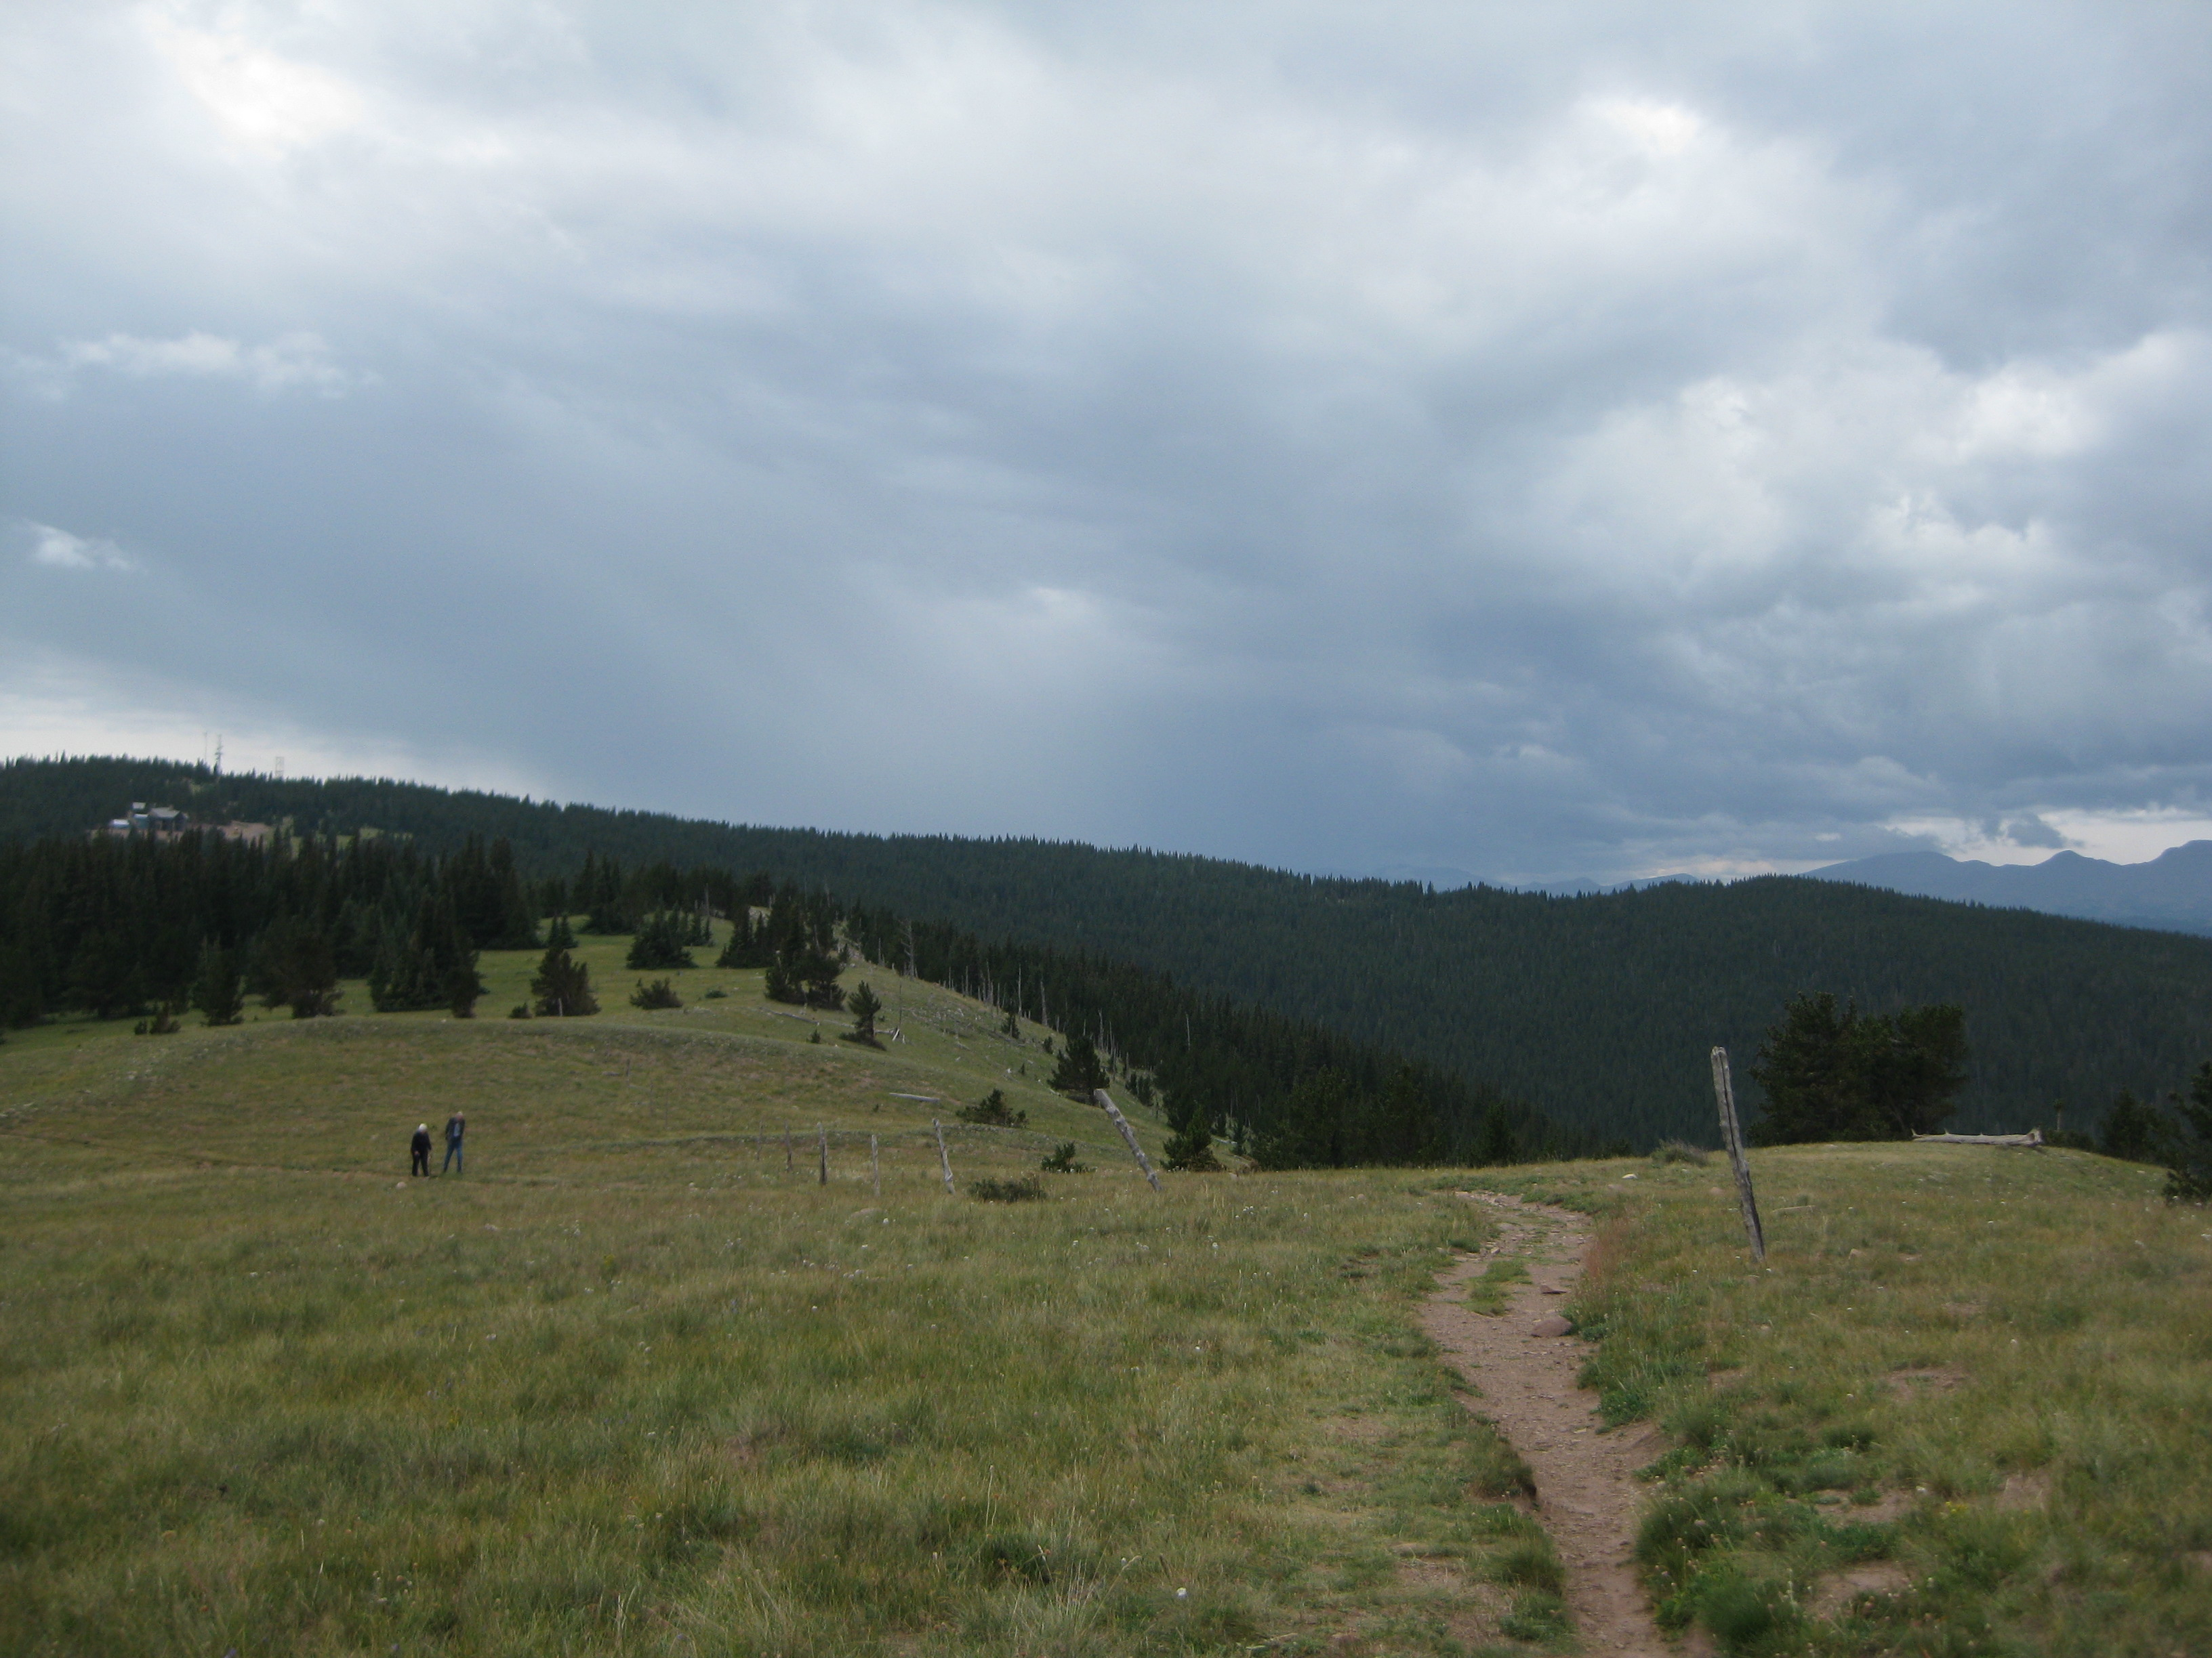
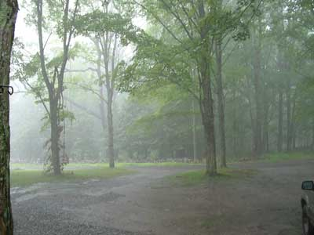
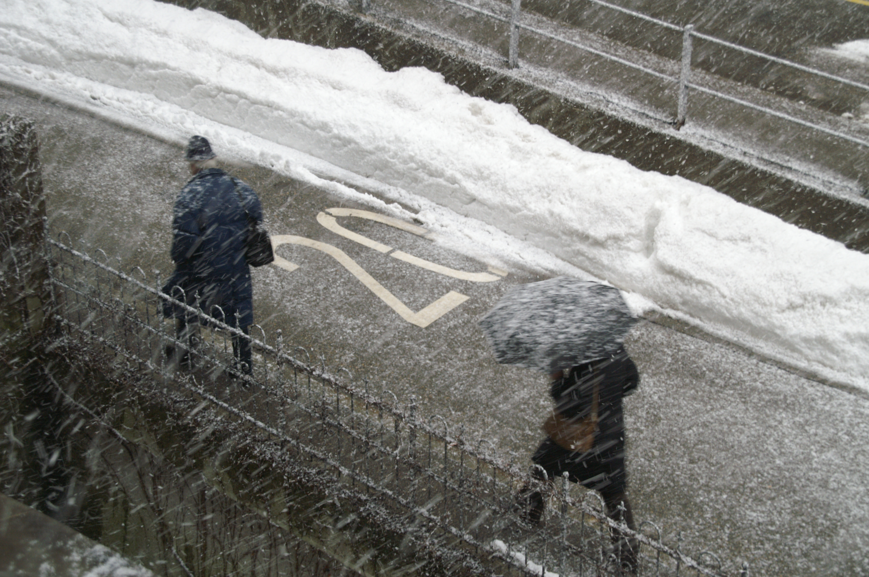
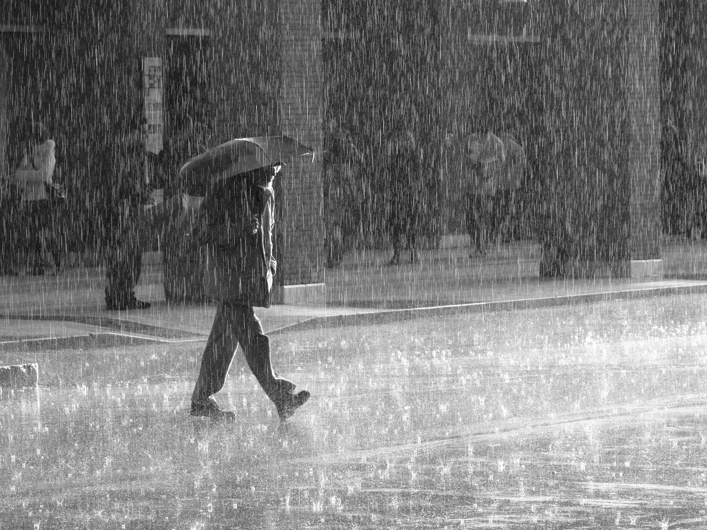

Slide 6
Priors

Slide 7
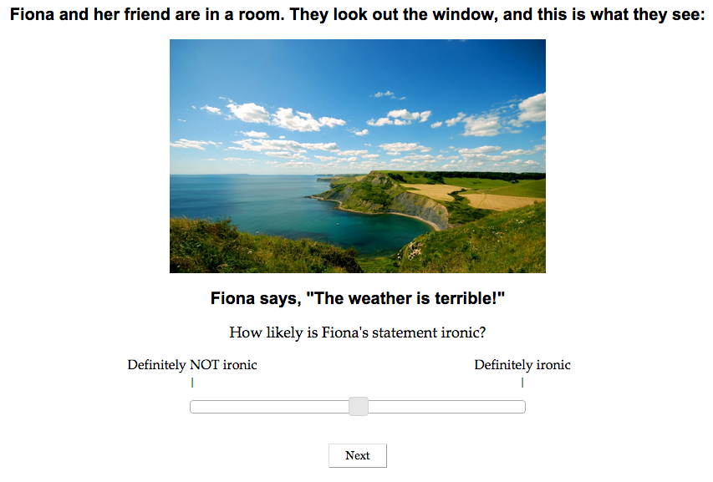

Slide 8
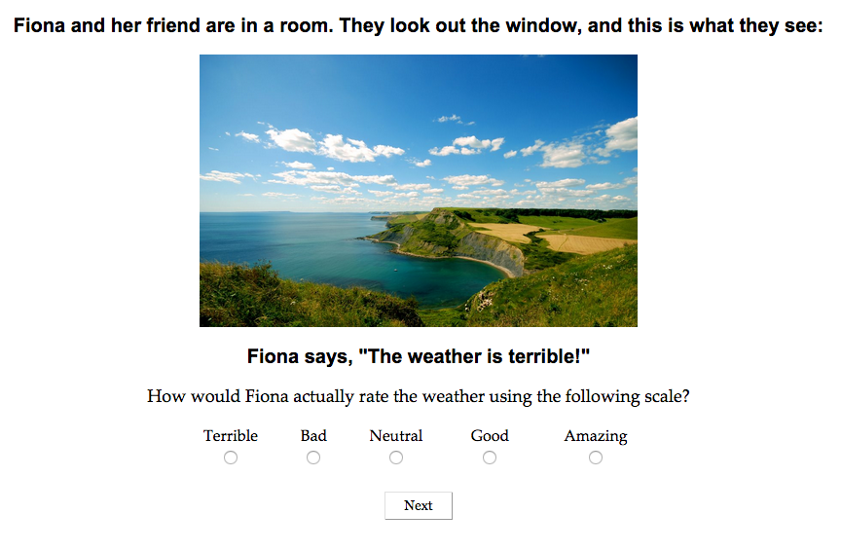

Slide 9
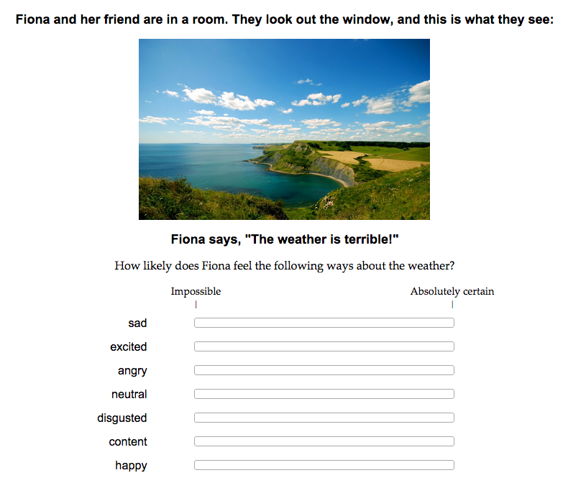

Slide 10
Irony ratings

Slide 11
Interpretation

Slide 12
Model
Priors
Weather state
Valence and arousal associated with each weather state
QUD
Weather state
Valence about weather
Arousal about weather
Given utterance, infer
QUD, weather state, valence, arousal

Slide 14
Weather state
r=0.84

Slide 15
Valence
r=0.95

Slide 16
Arousal
r=0.64

